Slide 1

Products for training
Library, with information for trainers

Slide 2
CONTENTS
Antimalarial products
RDTs

Slide 3
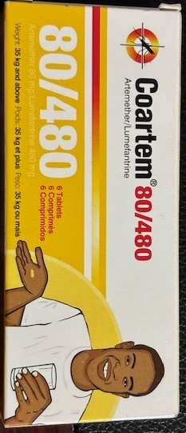
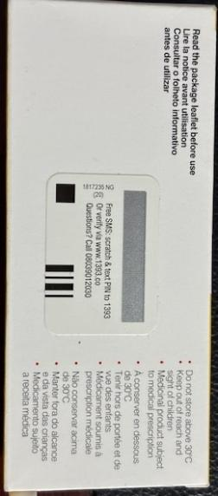
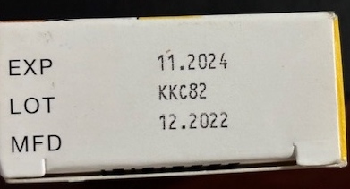
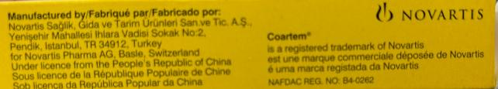
Dosage form: Tablet
Brand: Coartem 80/480, 35kg and above
Manufacturer: Novartis
Country of manufacture: Turkey
Active ingredient 1: Artemether
Strength: 80 mg
Active ingredient 2: Lumefantrine
Strength: 40 mg
Active ingredient 3: n/a
Strength: n/a
Salts: no
Pack type: Individual packet
Size: 6 tablets
FDC: yes

Slide 4
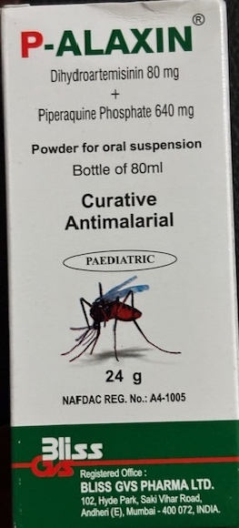
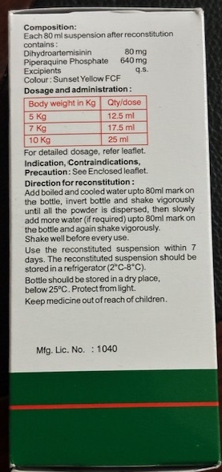
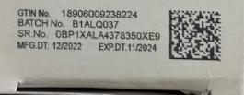
Dosage form: Suspension
Brand: P-alaxin 80/640
Manufacturer: Bliss GVS Pharma LTD
Country of manufacture: India
Active ingredient 1: Dihydroartemisinin
Strength:80 mg
Active ingredient 2: Piperaquine Phosphate
Strength:640 mg
Active ingredient 3: n/a
Strength: n/a
Salts: Phosphate
Pack type: individual packet
Size: 80ml
FDC: N/A

Slide 5
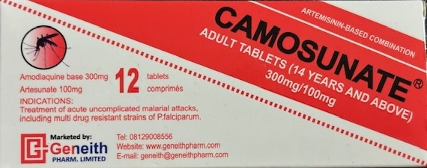
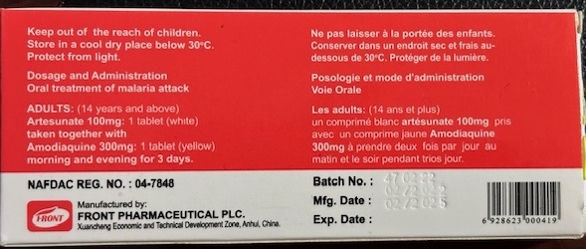
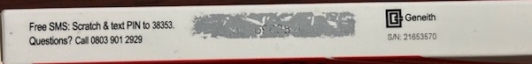
Dosage form: Tablets
Brand: Camosunate 300/100, 14 years and above
Manufacturer: Front Pharmaceutical, PLC
Country of manufacture: China
Active ingredient 1: Amodiaquine
Strength: 300 mg
Active ingredient 2: Artesunate
Strength: 100 mg
Active ingredient 3: n/a
Strength: n/a
Salts: n/a
Pack type: individual packet
Size: 12
FDC: No

Slide 6
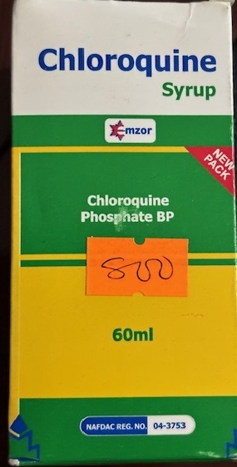
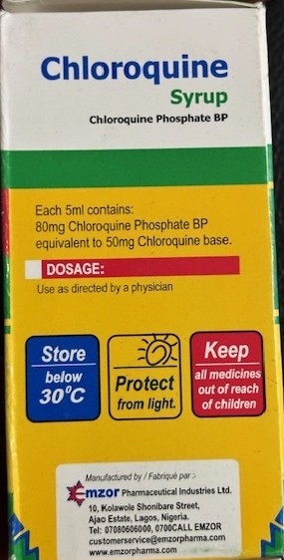
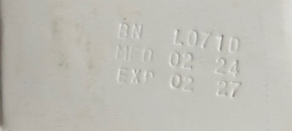
Dosage form: Syrup
Brand: Chloroquine syrup
Manufacturer: Mzor Pharmaceutical Industries Ltd.
Country of manufacture: Nigeria
Active ingredient 1: Chloroquine
Strength: 50mg (base)
Active ingredient 2: n/a
Strength: n/a
Active ingredient 3: n/a
Strength: n/a
Salts: Phosphate
Pack type: individual packet
Size: 60 ml
FDC: N/A

Slide 7
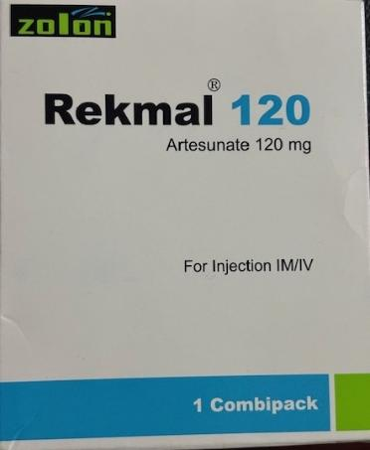
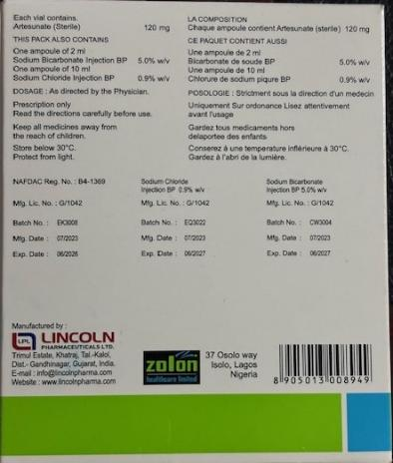
Dosage form: Powder injectable
Brand: Rekmal 120
Manufacturer: Lincoln Pharmaceuticals LTD
Country of manufacture: India
Active ingredient 1: Artesunate
Strength: 120 mg
Active ingredient 2: n/a
Strength: n/a
Active ingredient 3: n/a
Strength: n/a
Salts: n/a
Pack type: vial
Size: 1
FDC: N/A

Slide 8
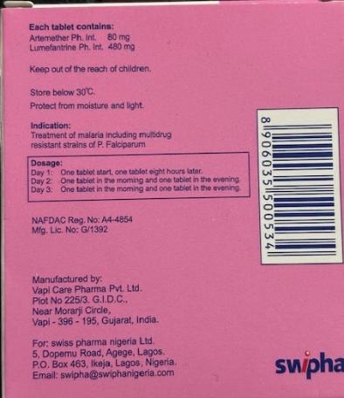
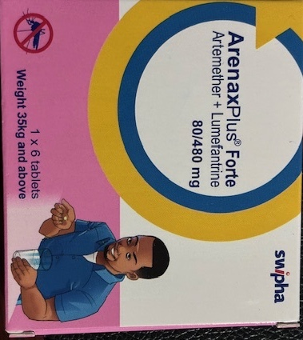
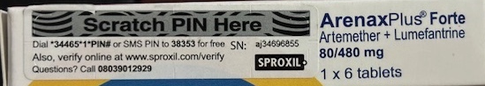
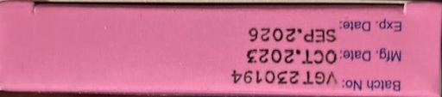
Dosage form: Tablets
Brand: ArenaxPlus Forte 80/480, 35kg and above
Manufacturer: Swiss Pharma Nigeria LTD
Country of manufacture: India
Active ingredient 1: Artemether
Strength: 80 mg
Active ingredient 2: Lumefantrine
Strength: 480 mg
Active ingredient 3: n/a
Strength: n/a
Salts: no
Pack type: tablets
Size: 6
FDC: yes

Slide 9
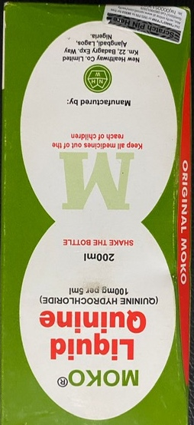
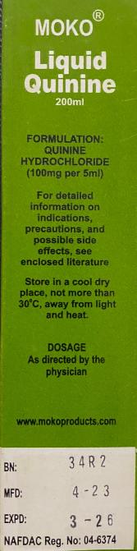
Dosage form: Suspension
Brand: MOKO Liquid Quinine
Manufacturer: New Healthway Co. Limited
Country of manufacture: Nigeria
Active ingredient 1: Quinine
Strength:
Active ingredient 2: n/a
Strength: n/a
Active ingredient 3: n/a
Strength: n/a
Salts: n/a
Pack type: bottle
Size: 200 ml
FDC: N/A

Slide 10
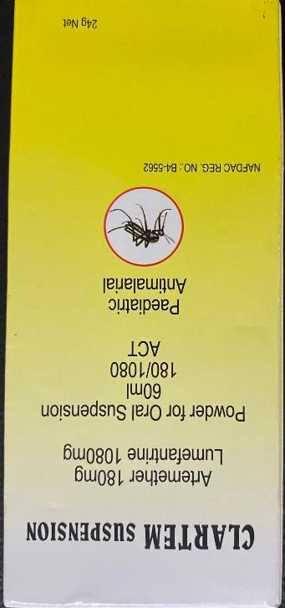
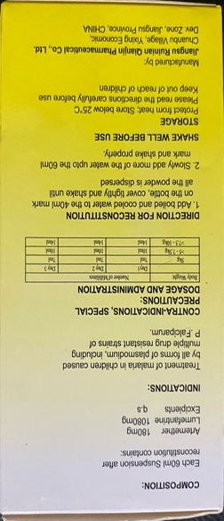
Dosage form: Suspension
Brand: Clartem Suspension
Manufacturer: Jiangsu Ruinian Qianjin Pharmaceutical Co, LTD
Country of manufacture: China
Active ingredient 1: Artemether
Strength: 180 mg
Active ingredient 2: Lumefantrine
Strength: 1080 mg
Active ingredient 3: n/a
Strength: n/a
Salts: n/a
Pack type: bottle
Size: 60 ml
FDC: N/A

Slide 11
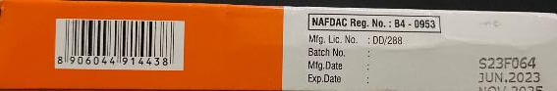
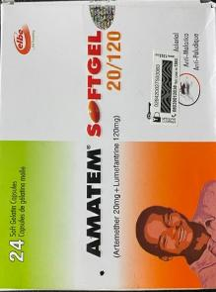
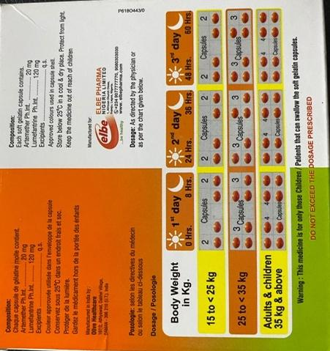
Dosage form: Tablet
Brand: Amatem Softgel 20/120
Manufacturer: Elbe Pharma Nigeria Limited
Country of manufacture: India
Active ingredient 1: Artemether
Strength: 20 mg
Active ingredient 2: Lumefantrine
Strength: 120 mg
Active ingredient 3: n/a
Strength: n/a
Salts: n/a
Pack type: individual packet
Size: 24
FDC: yes

Slide 12
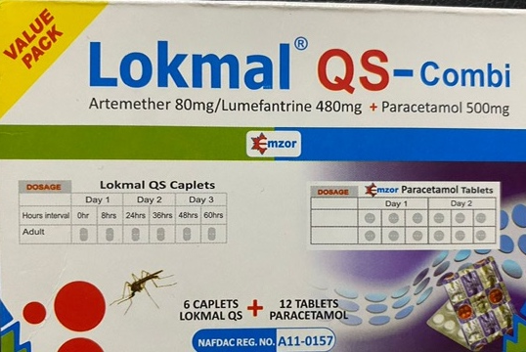
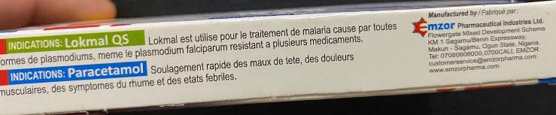
Dosage form: Tablets
Brand: Lokmal QS-Combi
Manufacturer: Mzor Pharmaceutical Industries LTD
Country of manufacture: Nigeria
Active ingredient 1: Artemether
Strength: 80 mg
Active ingredient 2: Lumefantrine
Strength: 480 mg
Active ingredient 3: n/a
Strength: n/a
Salts: n/a
Pack type: Individual packet
Size: 6 (don’t count paracetamol)
FDC: yes
Other comments: AL co-packaged with paracetamol

Slide 13
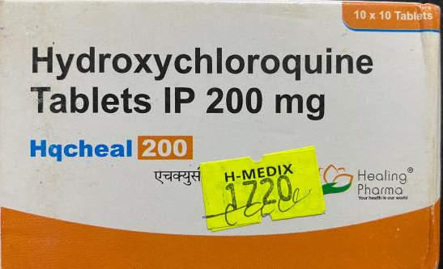
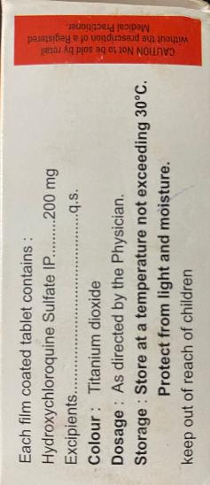
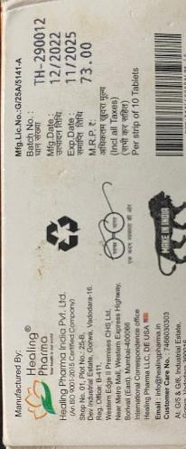
Dosage form: Tablets
Brand: Hqcheal 200 Hydroxycloroquine Tablets IP
Manufacturer: Healing Pharma India Pvt Ltd
Country of manufacture: India
Active ingredient 1: Hydroxychloroquine
Strength: 200 mg
Active ingredient 2: n/a
Strength: n/a
Active ingredient 3: n/a
Strength: n/a
Salts: Sulfate
Pack type: Individual packet
Size: 100 tablets
FDC: yes

Slide 14
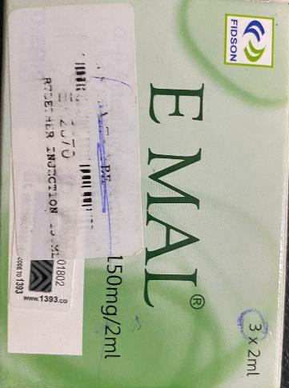
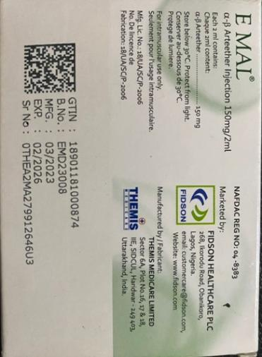
Dosage form: Liquid injectable
Brand: E MAL 150/2
Manufacturer: Themis Medicare Limited
Country of manufacture: India
Active ingredient 1: Arteether
Strength: 150 mg/2 ml
Active ingredient 2: n/a
Strength: n/a
Active ingredient 3: n/a
Strength: n/a
Salts: n/a
Pack type: Individual packet
Size: 3 x2 ml
FDC: n/a

Slide 15
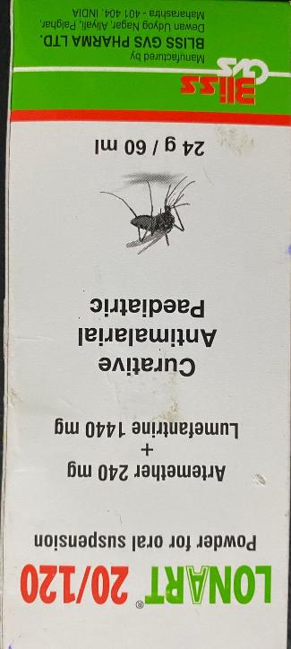
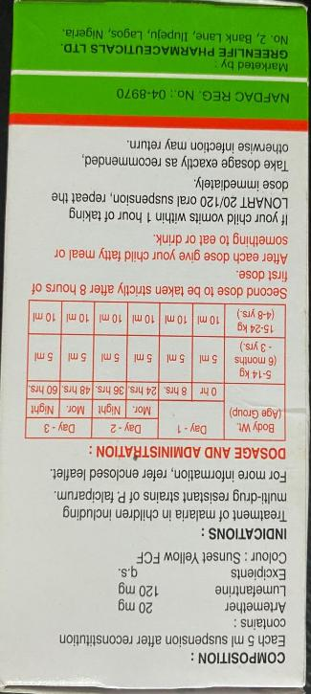
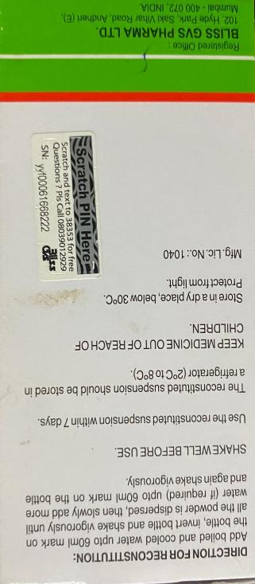
Dosage form: suspension
Brand: Lonart 20/120
Manufacturer: Bliss GVS Pharma LTD
Country of manufacture: India
Active ingredient 1: 20 mg
Strength: 120 mg
Active ingredient 2: n/a
Strength: n/a
Active ingredient 3: n/a
Strength: n/a
Salts: n/a
Pack type: bottle
Size: 60 ml
FDC: n/a

Slide 16
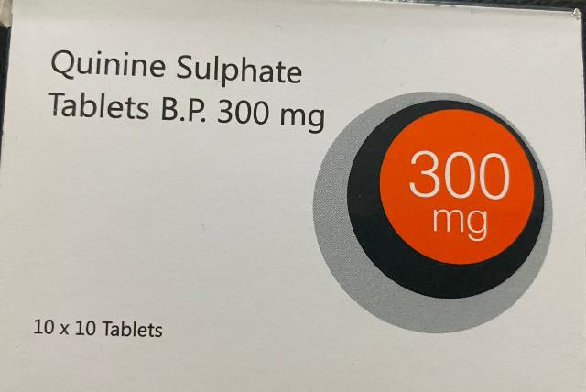
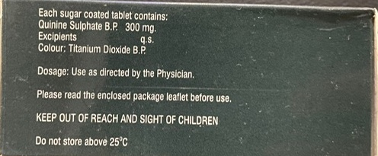
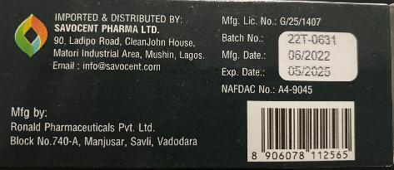
Dosage form: Tablets
Brand: Quinine Sulphate
Manufacturer: Ronald Pharmaceuticals Pvt Ltd
Country of manufacture: India
Active ingredient 1: Quinine
Strength: 300 mg
Active ingredient 2: n/a
Strength: n/a
Active ingredient 3: n/a
Strength: n/a
Salts: Sulphate
Pack type: individual packet
Size: 100 tablets
FDC: yes

Slide 17
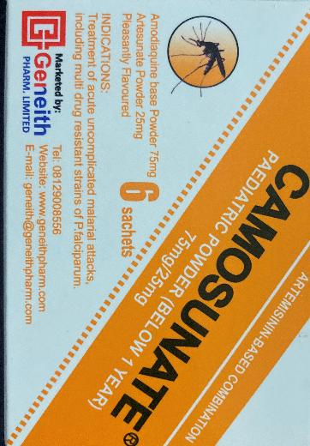
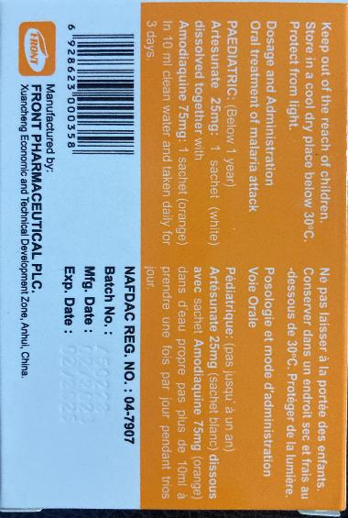
Dosage form: Granule
Brand: Camosunate pediatric powder (below 1 year)
Manufacturer: Front Pharmaceutical PLC
Country of manufacture: China
Active ingredient 1: Amodiaquine
Strength: 75 mg
Active ingredient 2: Artesunate
Strength: 25 mg
Active ingredient 3: n/a
Strength: n/a
Salts: n/a
Pack type: Individual packet
Size: 6 sachets
FDC: yes

Slide 18
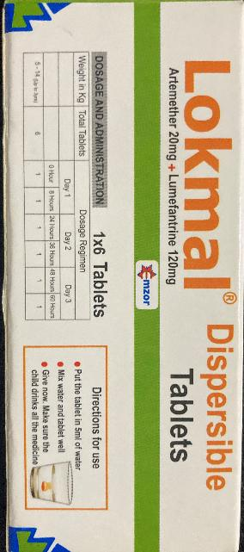
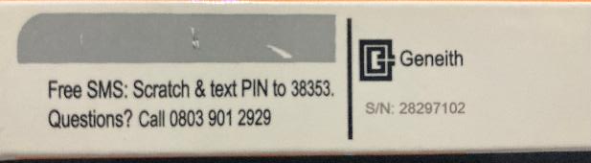
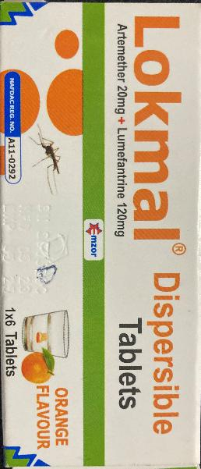
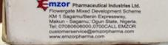
Dosage form: Tablets
Brand: Lokmal Dispersible
Manufacturer: Mzor Pharma Industries LTD
Country of manufacture: Nigeria
Active ingredient 1: Artemether
Strength: 20 mg
Active ingredient 2: Lumefantrine
Strength: 120 mg
Active ingredient 3: n/a
Strength: n/a
Salts: n/a
Pack type: individual packet
Size: 6 tablets
FDC: yes

Slide 19
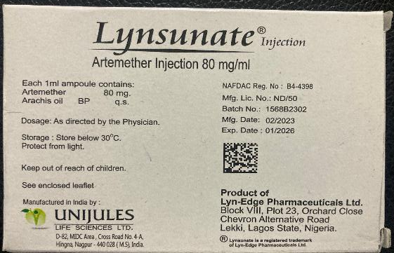
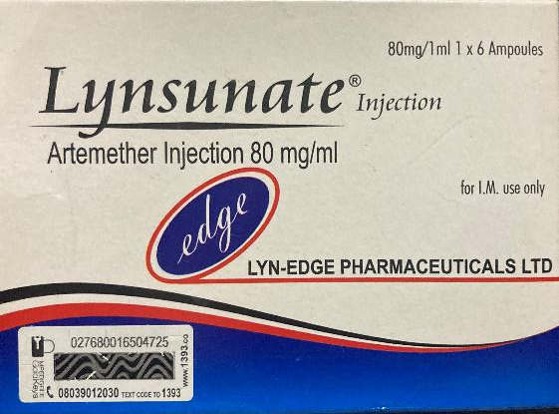
Dosage form: Liquid injectable
Brand: Lynsunate Injection
Manufacturer: Lyn-Edge Pharmaceuticals Ltd
Country of manufacture: India
Active ingredient 1: Artemether
Strength: 80 mg
Active ingredient 2: n/a
Strength: n/a
Active ingredient 3: n/a
Strength: n/a
Salts: n/a
Pack type: Individual packet
Size: 6 ampoules
FDC: n/a

Slide 20
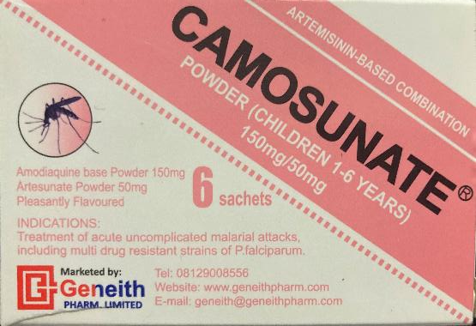
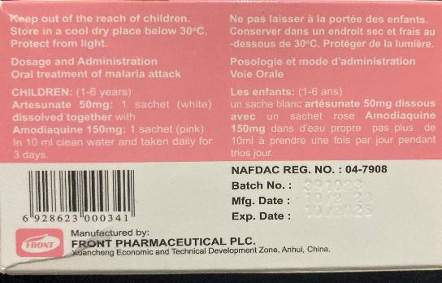
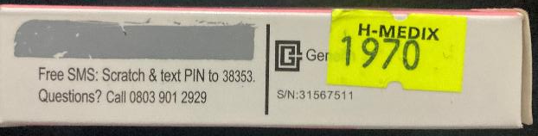
Dosage form: Granule
Brand: Camosunate Powder (Children 1-6 years)
Manufacturer: Front Pharmaceutical PLC
Country of manufacture: China
Active ingredient 1: Amodiaquine
Strength: 150 mg
Active ingredient 2: Artesunate
Strength: 50 mg
Active ingredient 3: n/a
Strength: n/a
Salts: n/a
Pack type: Individual packet
Size: 6 sachets
FDC: n/a

Slide 21


Dosage form: Tablets
Brand: P-ALAXIN TS
Manufacturer: Bliss GVS Pharma LTD
Country of manufacture: India
Active ingredient 1: Dihydroartemisin
Strength: 120 mg
Active ingredient 2: Piperaquine
Strength: 960 mg
Active ingredient 3: n/a
Strength: n/a
Salts: Phosphate
Pack type: Individual packet
Size: 3 tablets
FDC: yes

Slide 22



Dosage form: Tablets
Brand: SWIDAR
Manufacturer: Swiss Pharma Nigeria Ltd
Country of manufacture: Nigeria
Active ingredient 1: Sulfadoxine
Strength: 500 mg
Active ingredient 2: Pyrimethamine
Strength: 25 mg
Active ingredient 3: n/a
Strength: n/a
Salts: n/a
Pack type: individual packet
Size: 3 tablets
FDC: yes

Slide 23



Dosage form: Tablet
Brand: AMATEM FORTE SOFTGEL
Manufacturer: Olive Healthcare
Country of manufacture: India
Active ingredient 1: Artemether
Strength: 80 mg
Active ingredient 2: Lumefantrine
Strength: 480 mg
Active ingredient 3: n/a
Strength: n/a
Salts: n/a
Pack type: individual packet
Size: 6 capsules
FDC: yes

Slide 24


Dosage form: Tablets
Brand: HQCHEAL 200
Manufacturer: Healing Pharma
Country of manufacture: India
Active ingredient 1: Hydroxychloroquine
Strength: 200 mg
Active ingredient 2: n/a
Strength: n/a
Active ingredient 3: n/a
Strength: n/a
Salts: sulfate
Pack type: individual packet
Size: 100 tablets
FDC: yes

Slide 25
RDTs

Slide 26


Brand name: Malaria Parasite
Parasite specie(s): Pf
Antigen test(s): unknown
Manufacturer: New Heights Pharmaceuticals Ltd.
Country of manufacture: Nigeria

Slide 27

Brand name: Meriscreen
Parasite specie(s): Pf/Pan
Antigen test(s): HRP2/pLDH
Manufacturer: Meril Diagnostics Pvt Ltd
Country of manufacture: India

Slide 28




Brand name: Dr. Greg’s Malaria P.f Antigen Home Test Kit
Parasite specie(s): Pf
Antigen test(s): unknown
Manufacturer: unknown
Country of manufacture: unknown

